Slide 1
ABCs of Financial Fitness for Educators:
The Countdown to Retirement Starts NOW
National Life Group® is a trade name of National Life Insurance Company, Montpelier, VT, Life Insurance Company of the Southwest, Addison, TX and their affiliates. Each company of National Life Group is solely responsible for its own financial condition and contractual obligations. Life Insurance Company of the Southwest is not an authorized insurer in New York and does not conduct insurance business in New York. This information is not intended as tax or legal advice. For advice concerning your own situation, please consult with your appropriate professional advisor.
(if you are registered with ESI please also fill in and add the following, other wise delete this before submitting for advertising review:)
[Agent Name] is a Registered Representative and Investment Adviser Representative of, and securities and investment advisory services are offered solely by Equity Services, Inc. (ESI), Member FINRA/SIPC. [branch office address and telephone number]. [DBA name] is independent of ESI. ESI is a Broker/Dealer affiliate of National Life Insurance Company.

Slide 2
The Countdown
to Retirement Starts NOW
TCXXXXXX(1020)X | Cat No 105571(1020)
TC117312(1020)1 | Cat No 105571(1020)
Notes:
What exactly does the countdown to retirement mean?
[Discusses planning for retirement]
Let’s get started.
[next slide]

Slide 3
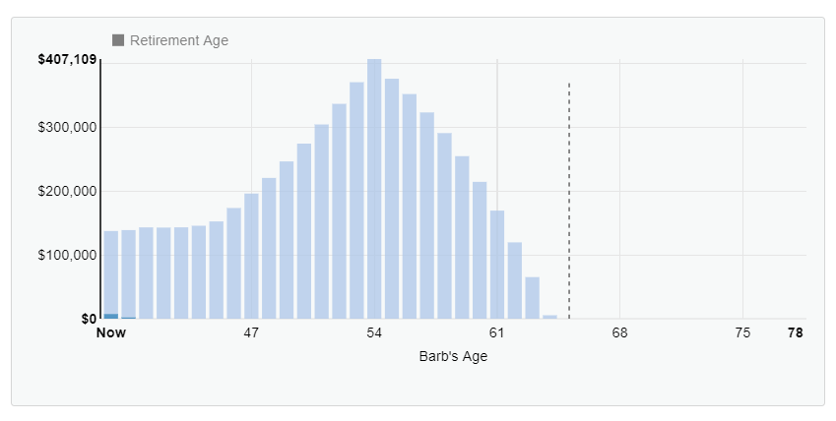
ABCs of Financial Fitness for Educators
The Countdown to Retirement Starts NOW
Bill and Barb
Nest Egg: Projected Savings Rate at Age 55
Required | $706,749.05
Projected | $407,109.45
Shortfall | $299,639.61
How do we help the couple achieve their retirement goals?
Traditional Retirement Age
Hypothetical example for illustrative purposes only. Does not represent the actual results of any particular investment or insurance product. All following examples assume portfolio shifts from more aggressive to more conservative as retirement gets closer. Interest rates assumed are 7.5% at beginning of example, 5.8% at end, and an average interest rate of 6.2%. Does not include the effect of fees or taxes.
Notes:
Here we have Bill and Barb. Right now, what’s required for them to meet their goals is about $700,000. But, based on their savings they’re projected to only have $400,000. So as we can see, we have about a $300,000 shortfall which is what we’re aiming to fix throughout this presentation and help them achieve their goals.
Bill is 42 years old and Barb is 40. Bill is a store manager at Target and makes $50,000 a year. Barb is a teacher and she also makes $50,000. She gets a pension. Bill wants to retire at age 67 and Barb wants to retire at 55 when her pension starts. Overall, they spend $6,500 per month on their living expenses and they’re looking to spend about $4,000 in retirement after their kids are out of the house.
How would you help them reach those goals?
[next slide]

Slide 4
ABCs of Financial Fitness for Educators
The Countdown to Retirement Starts NOW
Push and Pull the Levers
Spending / Saving
Time Horizon
Retirement Spending
Bridge Work
Social Security
Notes:
[intro concept of push and pull levers and talks about spending/saving]
One thing we want to make sure they’re doing is jump into their budget and lower their expenses so they can increase the amount they’re saving.
We discussed in the webinar on cash flow people are spending more than they make.
Key to wealth is spending less than you make and that’s where Bill & Barb are.
We also need to look at the time horizon. Barb’s goal is lofty, wanting to retire at age 55 so we may need to make some adjustments there.
A lot of people seem to think they’ll be spending less than they retire so they won’t need as much money. That may be true in some cases, but also people may travel more, go out to eat more, etc. so we just want to make sure our plan allows for us to live the lifestyle we want.
[ Retirement spending]
What about retiring from your career but then taking a job doing something else?
[ Bridge work]
A part time job could allow people to withdraw less from their retirement savings.
A LOT of people seem to think SS is going to be enough. Often times this isn’t enough so we really want to make sure we have supplemental income as well.
[ Social Security]
Let’s dig deeper into each of these topics
[Next slide]

Slide 5
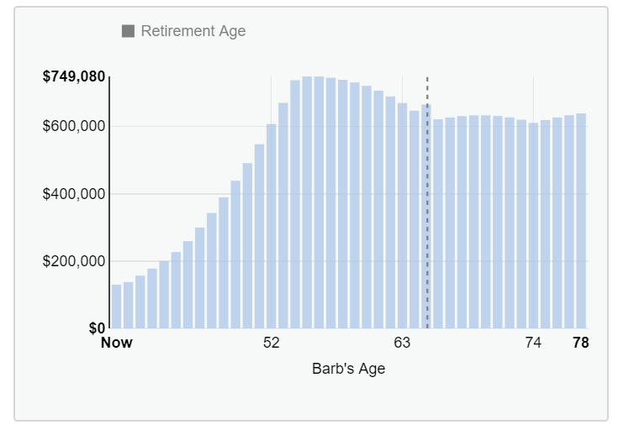
ABCs of Financial Fitness for Educators
The Countdown to Retirement Starts NOW
Nest Egg: Projected Savings Rate at Age 55
Required | $706,749.05
Projected | $753,350.69
Spending / Saving
u
Saved $1,000 extra per month.
u
Reduce:
Housing costs
Travel expenses
Overall monthly budget.
Traditional Retirement Age
Notes:
[Discusses the daunting task of identifying budget but such a dramatic change when maximizing retirement savings. Examples: downsizing/adjust housing costs, traveling less, etc.]
It increases their projected retirement savings by over $300k
[Ways to save]
$1000 is a lot for many people to save
[Other ways to pull the lever]
[Next slide]

Slide 6
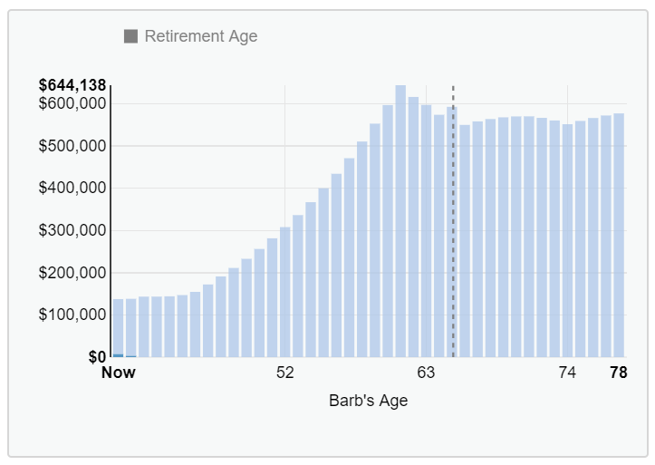
ABCs of Financial Fitness for Educators
The Countdown to Retirement Starts NOW
Nest Egg: Projected Savings Rate at Age 62
Required | $575,537.05
Projected | $644,137.85
Time Horizon
u
Barb retires at 62.
u
Increase retirement age.
u
Extend time frame to make a large purchase, such as a new home.
Traditional Retirement Age
Notes:
Working a few extra years makes a big difference.
I’m sure a lot of people really don’t want to delay retirement
If working a few more years isn’t an option, there are other steps we could take.
[next slide]

Slide 7
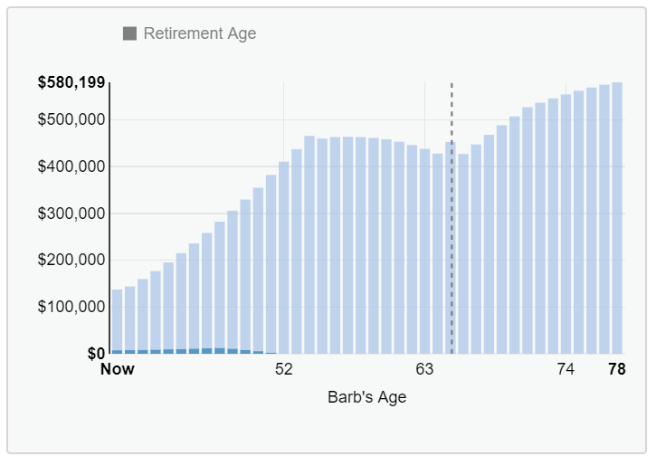
ABCs of Financial Fitness for Educators
The Countdown to Retirement Starts NOW
Nest Egg: Projected Savings Rate at Age 55
Required | $314,712.66
Projected | $407,109.45
Retirement Spending
u
Reduce expenses in retirement by $1,000.
u
Downsize on housing with no kids.
u
Move to lower tax state.
u
Lower taxes during retirement years.
Traditional Retirement Age
Notes:
[Reducing retirement spending]
Many people want to move to Florida or the mountains for retirement
[Move to lower tax state, lower taxes in retirement]
I think an important note is that many people think of retirement as an extended vacation
[There’s more cost to that, segue to bridge work]
[next slide]

Slide 8
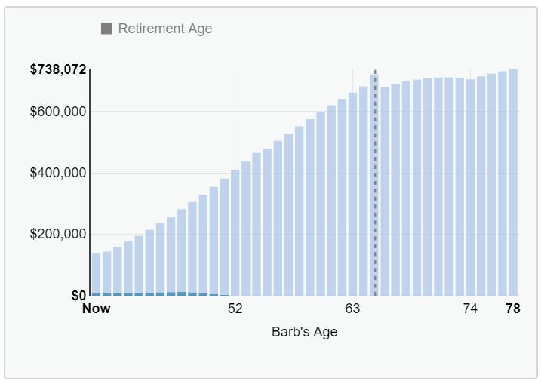
ABCs of Financial Fitness for Educators
The Countdown to Retirement Starts NOW
Nest Egg: Projected Savings Rate at Age 55
Required | $402,964.98
Projected | $465,667.29
Bridge Work
u
Part time work after retirement from full time work.
u
Pull in some extra money that reduces your portfolio withdrawals.
u
Do something you love.
u
Keep yourself busy and entertained.
Traditional Retirement Age
Notes:
[stress of working, doing something you’re passionate about part time, gives you a reason to get out of bed]
That really reduces the required retirement income in this projection.
[Reduces portfolio withdrawal so don’t need as much with bridge work income and also social security]
[next slide]

Slide 9
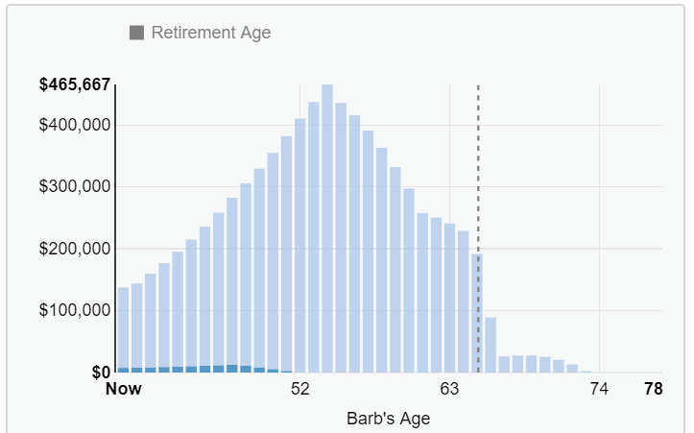
ABCs of Financial Fitness for Educators
The Countdown to Retirement Starts NOW
Nest Egg: Projected Savings Rate at Age 55
Required | $542,983.12
Projected | $465,667.29
Shortfall | $77,315.82
Social Security
u
Barb collects at 62 and Bill collects at 70.
u
Wait until age 70 to receive an 8% increase per year from 65.
u
Collect early at 62 and permanently reduce your benefits.
Neither National Life Group nor its representatives are affiliated with any government agency. Information regarding Social Security is provided for educational purposes only and does not replace information provided to you by the Social Security Administration.
Traditional Retirement Age
Copyright © 2020 National Life Group
Notes:
[ social security alone isn’t enough and making changes to social security is not going to fix your situation]
It’s a very common misconception that SS alone is enough and way too many people rely on SS alone
Really need to plan for a combination of all these techniques.
[next slide]

Slide 10
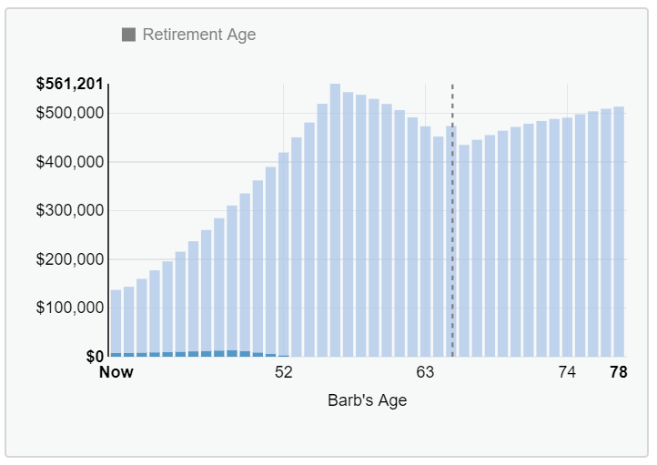
ABCs of Financial Fitness for Educators
The Countdown to
Retirement Starts NOW
Nest Egg: Projected Savings Rate at Age 57
Required | $476,484.12
Projected | $561,200.64
Combination
u
Increase retirement age for Barb from 55 to 57.
u
Reduce expenses and increase savings by $500.
u
Reduce retirement expenses by $500.
Traditional Retirement Age
Notes:
[Explain how Barb and Bill solved their situation]
We can compromise and utilize a variety of techniques so we don’t have to make such dramatic changes in one area. It’s important to build your plan to plan for your financial future.
Q&A

Slide 11
Continue Your Education
Your Retirement Study Guide
Retirement Homeroom is full of features and functionality to help you further educate – and empower – yourself as you plan for retirement.
Explore
www.RetirementHomeroom.com

