Slide 1
ABCs of Financial Fitness for Educators:
Maximize Your Cash Flow for Today and Tomorrow
National Life Group® is a trade name of National Life Insurance Company, Montpelier, VT, Life Insurance Company of the Southwest, Addison, TX and their affiliates. Each company of National Life Group is solely responsible for its own financial condition and contractual obligations. Life Insurance Company of the Southwest is not an authorized insurer in New York and does not conduct insurance business in New York. This information is not intended as tax or legal advice. For advice concerning your own situation, please consult with your appropriate professional advisor.
(if you are registered with ESI please also fill in and add the following, other wise delete this before submitting for advertising review:)
[Agent Name] is a Registered Representative and Investment Adviser Representative of, and securities and investment advisory services are offered solely by Equity Services, Inc. (ESI), Member FINRA/SIPC. [branch office address and telephone number]. [DBA name] is independent of ESI. ESI is a Broker/Dealer affiliate of National Life Insurance Company.

Slide 2
Maximize Your Cash Flow for Today and Tomorrow
Notes:
[Introduce and tell a little bit about yourself].
We’re here today to talk about Cash Flow. I want to encourage you to stick around for the end where you’ll have the opportunity for a Q&A. Let’s get started.
Now, we have some questions for you.
Where are you in your journey towards retirement? Are you a) Just starting my career (20-30 years away from retirement) b) Probably mid-way through, (10-15 years away) or c) coming in for a landing (1-5 years away).
It’s never too early or too late to work on your financial future. Right now in this time of uncertainty, everyone wants more money in their pocket, but when we’re talking about maximizing cash flow for retirement purposes, what exactly does that mean?
[Go to next slide]

Slide 3
ABCs of Financial Fitness for Educators
Maximize Your Cash Flow
1. Identify your expenses.
u
Select a month that represents your ordinary expenses.
u
Add up the withdrawals from your bank accounts.
Include ATM and debit card expenses and ATM withdrawals. Do not include transfers.
u
Categorize expenses.
For example, childcare, groceries, and clothing.
Notes:
The first step is to identify your expenses. You want to know how much you spend in an average month, including credit and debit card charges and ATM withdrawals.

Slide 4
ABCs of Financial Fitness for Educators
Maximize Your Cash Flow
2. Surplus or deficit?
If there’s a surplus:
Save the extra cash for your financial goals.
Talk to your agent regarding your financial goals.
If there’s a deficit:
Add up:
Subtract:
Drill down on your expenses to find ways to cut.
Your total take home pay (what hits the bank).
Identified and calculated expenses.
This is when categorizing expenses comes in handy!
Notes:
Once you’ve added everything you’ve spent, you’ll need to calculate your take home pay and subtract your expenses to see if you have a surplus or a deficit.
[Feel free to ask questions about what to do with that surplus, discuss people who find themselves with a deficit, ways to cut cost i.e., cutting cable, bringing lunch, cooking at home, lead into next slide with what’s the next step]

Slide 5
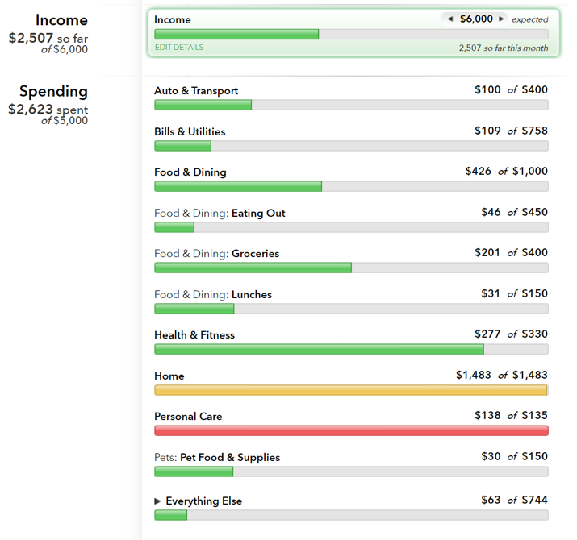
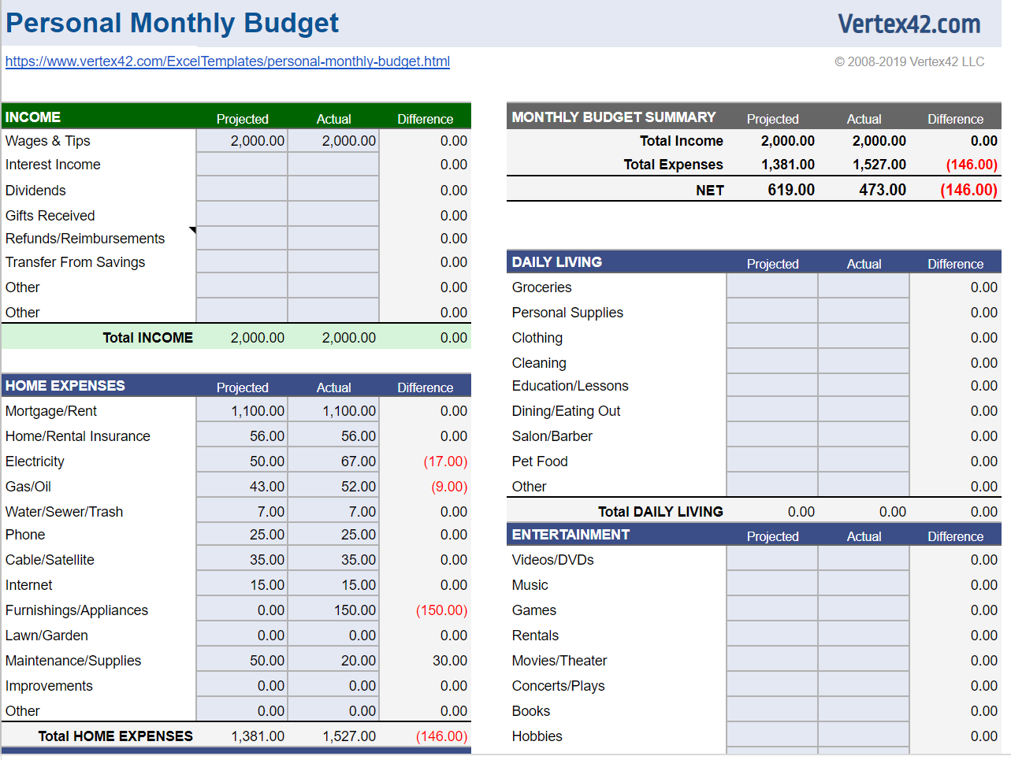
ABCs of Financial Fitness for Educators
Maximize Your Cash Flow
3. Make a budget
Save first then spend next: identify savings needs.
Use an app to track your budget, e.g. Mint or EveryDollar.
The key to wealth is spending less than you make.
TIP:
Make the grocery store, lunches, and restaurants separate budgets.
Check before you spend!
Look at your app before making a purchase.
Notes:
It’s worth reiterating the key to wealth is spending less than you make so that you can build your savings
You can either budget manually or through an app like Mint. Mint will show your progress in each category with a visual graph. I’d encourage you to use Mint because it’s real time tracking without you having to do any more legwork.
So, how do you determine how much to spend on what when you’re creating a budget?
[Go to next slide]

Slide 6
ABCs of Financial Fitness for Educators
Maximize Your Cash Flow
4. 50/30/20 Rule of Thumb
20%
Goes toward your financial future
50%
Goes to your needs
Paying down your debt
Building up your savings
Housing
Transportation
Insurance
Groceries
Healthcare
Utilities
30%
Goes toward your wants
Takeout dinners
Concert tickets
Cocktails with friends
New throw pillows
Fun tech gadgets
Notes:
[Talk through infograph]
What do you advise to those that have too much month left at the end of their paycheck?
[Go to next slide]

Slide 7
ABCs of Financial Fitness for Educators
Maximize Your Cash Flow
5. Fixing a deficit
u
Set mini goals.
$100/week for groceries instead of $400/month.
u
Recognize the difference between wants and needs.
Don’t let a “want” put you into debt.
What did I use before this new gadget?
Delay purchases until a lower expense month.
Make hard decisions.
Notes:
[Talking points on slide]
[Ask questions about creating the necessary discipline] We’ve talked about the importance of creating a budget. What other tips would you give someone trying to manage their spending?
[Go to next slide]

Slide 8
ABCs of Financial Fitness for Educators
Maximize Your Cash Flow
6. Simplify and name accounts
u
Easy to track money coming in and out of one main checking account.
Gives a true picture of what is left over.
u
Make a separate emergency fund account.
Groceries
u
Give your savings account a purpose, e.g. Disney Trip.
Clothing
Emergency
Disney Trip
Notes:
[Talking points on slide]
Now is the perfect time to plan ahead, whether that be for emergencies or your dream vacation.
[Go to next slide]

Slide 9
ABCs of Financial Fitness for Educators
Maximize Your Cash Flow
7. Debit cards
Are you self-disciplined with spending? If not, use a debit card.
u
You can only spend what you actually have. However you still need to be aware of purchases. If the bank hasn't recorded them yet you can overdraw your account and rack up significant fees.
u
Keep track of the timing of purchases so you have enough money for bills due.
u
Be careful of miscellaneous cash withdrawals.
u
Debit cards have less protection against fraud.
Notes:
Another tip for someone who isn’t as disciplined is to use debit cards versus a credit cards mainly because there’s a finite amount in that account. For example, you could use a prepaid card like CashApp or Venmo card to limit spending and avoid bank fees.
[Go to next slide]

Slide 10
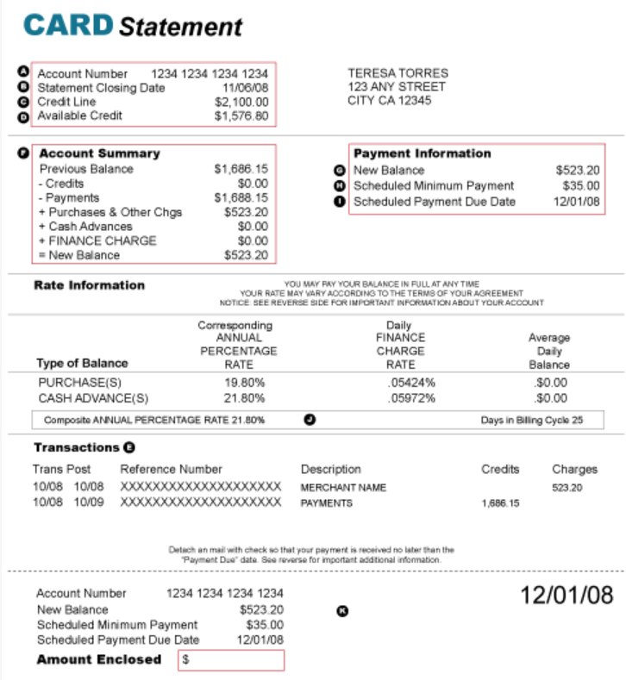
ABCs of Financial Fitness for Educators
Maximize Your Cash Flow
8. Credit cards
Green: Pay off in full
Blue: Minimum payment
Purple: High interest rate
Rewards available
Protection against theft
Notes:
If you’re pretty self-disciplined, you can use credit cards and pay if off in full each month to avoid paying interest. Plus, your credit card rewards can really add up. You just have to plan and use your credit cards wisely.
[go to next slide]

Slide 11
ABCs of Financial Fitness for Educators
Maximize Your Cash Flow
9. Large purchases
SALE!
If possible, plan in advance.
Divide the amount needed by the weeks left to goal.
Save $25/week to have $1,300 by Christmas.
Buy on days with big sales, e.g. Black Friday or Cyber Monday.
If it’s an emergency, utilize your emergency fund savings to stay out of debt.
Notes:
Same thing with large purchases, plan in advance: add it into your budget or plan for sales.
We’ve been talking about being disciplined with our spending. What about being disciplined with saving? I know a lot of people really struggle with that.
[go to next slide]

Slide 12
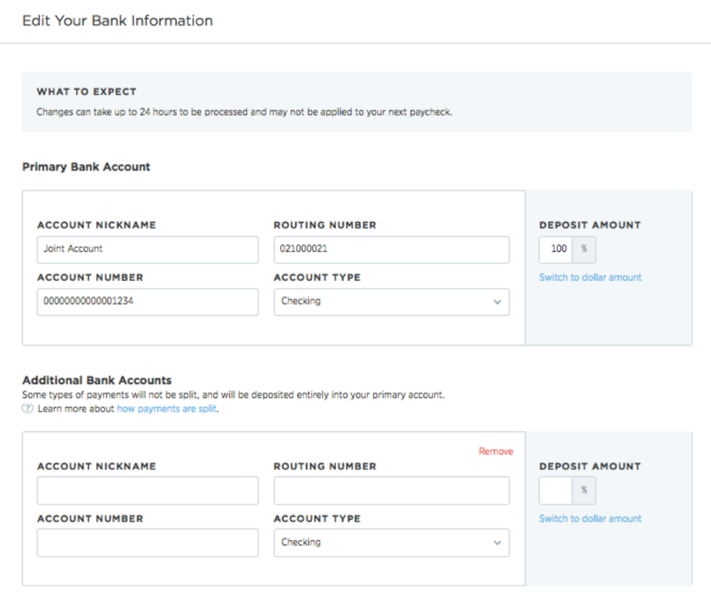
ABCs of Financial Fitness for Educators
Maximize Your Cash Flow
10. Automatic savings
u
Save first, spend the leftovers.
u
Split your direct deposit to automatically save a designated amount into a savings account.
u
Sign up for retirement account contributions through your employer.
Notes:
Here are some tips on that. [Talking points on slide]
At this time we’re going to open it up for Q&A.
[Q&A Session]
That’s all the questions we have time for today. We thank you for joining us.

Slide 13
Continue Your Education
Your Retirement Study Guide
Retirement Homeroom is full of features and functionality to help you further eductate – and empower – yourself as you plan for retirement.
Explore
www.RetirementHomeroom.com

