Slide 1
Retirement Readiness:
Building Your Future, Today
Products issued by
National Life Insurance Company® | Life Insurance Company of the Southwest®
National Life Group® is a trade name of National Life Insurance Company, Montpelier, VT, Life Insurance Company of the Southwest (LSW), Addison, TX and their affiliates. Each company of National Life Group is solely responsible for its own financial condition and contractual obligations. LSW is not an authorized insurer in New York and does not conduct insurance business in New York.
The companies of National Life Group and their representatives are neither endorsed by, nor affiliated with, any school, district, or government agency. This information is not intended as tax or legal advice. For advice concerning your own situation, please consult with your appropriate professional advisor.
Notes:
Welcome & Agent Introduction.

Slide 2

Retirement Math
California
What’s the Average Retirement Income of a
K-12 employee in CA?
$39,600
$68,000
$47,000
Source— https://www.teacherpensions.org/blog/update-what-average-teacher-pension-my-state , January 2019
Notes:
Knowing what your state’s “average pension” can be interesting. But this amount doesn’t necessarily reflect the amount that many teachers actually earn.
Source—https://www.teacherpensions.org/blog/update-what-average-teacher-pension-my-state , January 2019

Slide 3

Retirement Math
Georgia
What’s the Average Retirement Income of a K-12 employee in GA?
$30,000
$75,000
$37,613
Source: https://www.teacherpensions.org/blog/update-what-average-teacher-pension-my-state , January 2019
Notes:
Knowing what your state’s “average pension” can be interesting. But this amount doesn’t necessarily reflect the amount that many teachers actually earn.
Source—https://www.teacherpensions.org/blog/update-what-average-teacher-pension-my-state , January 2019

Slide 4

Retirement Math
Texas
What’s the Average Retirement Income of a K-12 employee in TX?
$27,600
$15,570
$24,999
Source: https://www.teacherpensions.org/blog/update-what-average-teacher-pension-my-state , January 2019
Notes:
Knowing what your state’s “average pension” can be interesting. But this amount doesn’t necessarily reflect the amount that many teachers actually earn.
Source—https://www.teacherpensions.org/blog/update-what-average-teacher-pension-my-state , January 2019

Slide 5
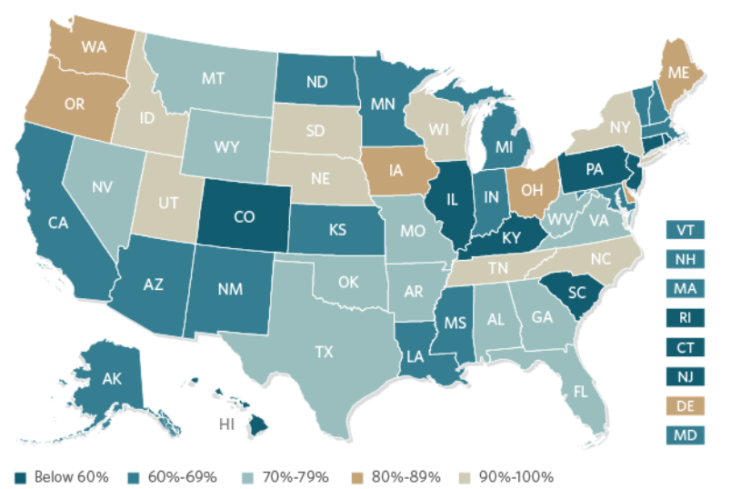
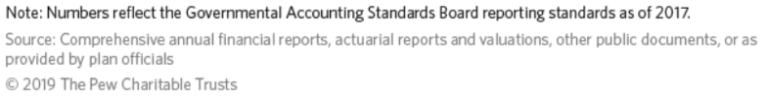
The Problem With Pension Funding
State Pension Funding in 2017
8 States: 90% funded
24 States: below 70% funded
*source: reason.org
Notes:
https://www.pewtrusts.org/en/research-and-analysis/issue-briefs/2019/06/the-state-pension-funding-gap-2017
Each state’s funded ratio is a weighted average for the largest state-administrated pension plans in that particular state. A funded ratio is simply a measurement of how much a pension plan has saved relative to the benefits it has promised, the percentage is calculated by dividing the market value of assets by the actuarial value liabilities (i.e., the net present value of promised pension checks).
States that report fully funded pension plans (100% or more) are depicted in shades of green. Funding ratios ranging from 70% to 99% are displayed in shades of yellow/orange, while any state that falls below a 70% funded ratio appears in shades of red.

Slide 6
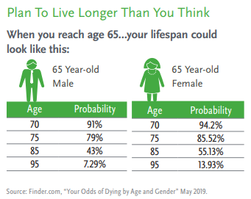
Life Expectancy
The longer you live, the longer you can expect to live.
52%
of workers fear outliving their savings/investments.
Source: “How Much Do I Need to Retire?”, Retirement Living, 2019
$285k
Expected cost of healthcare while retired
Source: Estimates for Health Care Costs in Retirement Continue to Rise, April 2019. https://www.plansponsor.com/estimates-health-care-costs-retirement-continue-rise/
Notes:
A 65-year old couple retiring in 2019 can expect to spend $285,000 in health care and medical expenses throughout retirement according to Fidelity’s annual Retiree Health Care Cost Estimate.
For single retirees, the health care cost estimate is $150,000 for women and $135,000 for men.

Slide 7
Retirement Income Gap
In most cases Pension Income does not provide for full retirement income needs. As the Cost of Living increases, the income gap gets larger and larger.
Notes:
While inflation has been relatively low in recent years (less than 3 percent during the past decade) rates could increase which, in turn, would decrease your purchasing power for everything from healthcare to food to utilities.
Source: U.S. Inflation Calculator, "Current US Inflation Rates: 2008-2018"

Slide 8
Retirement Plans = Retirement Readiness
403(b) | 457 | 401(k)
Established in 1958 (58 Years) | Established in 1978 (38 Years) | Established in 1978 (38 Years)
Public School employees and tax-exempt organizations | State and Local governments | Corporations, For-Profit organizations
30% Participation | 49% Participation | 84.9% Participation
84.9% participate in 401(k) plans – ForUsAll 401k Blog – According to the latest survey by the Plan Sponsor Council of America., 2019 https://www.forusall.com/401k-blog/401k-statistics/
30% participate in 403(b) plans - NTSA "Improving Retirement Savings for America's Public Educators, A comprehensive survey of Public Education 403(b) Retirement Plans, 2018.
49% participate in 457 plans—Understanding the 457(b) Market, National Assoc. of Plan Advisors, November 2019
Notes:
403(b), 457 and 401(k) plans are all tax-advantaged retirement savings plans created by the IRS in order to help American’s with their financial readiness for retirement. While 403(b) and 457 plans have been in existence for 2 decades longer than 401(k) plans, these plans have significantly lower participation. The discrepancy in participation exists for several reasons:
Awareness--403(b) participants have far lower rates of awareness about plan availability, available savings options, how to participate and flexibility of contributions.
The false sense of security provided by a state pension program. Many K-12 & other public employees have a false sense of security that their pension will provide for all of their retirement income needs.

Slide 9

The Power of Pretax Savings
Pre-tax salary deferral allows you to save more for retirement, pay less in taxes, and earn interest on a tax-deferred basis.
Distributions from pre-tax retirement plans are taxed as ordinary income and, if taken prior to reaching age 59½ may be subject to an additional 10% federal income tax penalty.
Notes:
Pre-tax savings gives you the benefit of triple compounding. Your contributions are made via salary deferral which allows you to save more while making a reduced change to your take home pay, additionally the pre-tax contribution decreases your taxable earnings which reduces the amount you will pay in taxes and you will earn tax-deferred interest on the money you would have otherwise paid in taxes.
Taxes are not due until funds are withdrawn from the plan, and people with lower income in retirement will likely find themselves in a lower tax-bracket in their retirement years.

Slide 10

The HIGH cost of Waiting
Do you have
TIME or MONEY?
The longer you wait to save for the future, the more money you will need…to end up with the same amount or less.
Notes:
Example: Karen (40) & Julie (25). Julie starts saving $350/month in her 403(b) plan, and never increases contributions. Assuming 3% average annual interest she will have $326,185 at age 65. Karen waits until 40 to start saving. If she contributes $350/month and never increases and earns the same annual average of 3%, her total at age 65 is only $157,722. If she doubles monthly contributions to $700/month, her total savings at age 65 will grow to $315, 455, still less than if she had started earlier.
Reference: "The True Cost of Waiting to Save For Your Retirement" updated August 22,2018

Slide 11

The HIGH cost of Waiting
At age 25, Julie starts saving $350/month in her 403(b) plan, and never increases contributions. Assuming 3% average annual interest she will have $326,185 at age 65.
Karen waits until 40 to start saving. If she contributes $350/month and never increases and earns the same annual average of 3%, her total at age 65 is only $157,722. If she doubles monthly contributions to $700/month, her total savings at age 65 will grow to $315,455, still less than if she had started earlier.
Hypothetical example for illustrative purposes only — not representative of any particular investment.
Reference: "The True Cost of Waiting to Save For Your Retirement" updated August 22,2018
Notes:
Example: Karen (40) & Julie (25). Julie starts saving $350/month in her 403(b) plan, and never increases contributions. Assuming 3% average annual interest she will have $326,185 at age 65. Karen waits until 40 to start saving. If she contributes $350/month and never increases and earns the same annual average of 3%, her total at age 65 is only $157,722. If she doubles monthly contributions to $700/month, her total savings at age 65 will grow to $315, 455, still less than if she had started earlier.
Reference: “"The True Cost of Waiting to Save For Your Retirement" updated August 22,2018

Slide 12
Take Action Now
Employees participating in a retirement plan are
50% more confident
about having enough money to live comfortably throughout retirement.
Source: 2018 EBRI/Greenwald Retirement Confidence Survey
Notes:
Retirement confidence continues to be strongly related to retirement plan
participation, whether in a defined contribution (DC) plan, defined benefit (DB) plan, or individual retirement account (IRA). Workers reporting they or their spouse have money in a DC plan or IRA or have benefits in a DB plan from a current or previous employer are more than twice as likely as those without any of these plans to be at least somewhat confident (75 percent with a plan vs. 34 percent without a plan)
Source: 2018 EBRI/Greenwald Retirement Confidence Survey
Take action today, in order to give yourself peace of mind for the future. Complete the appointment card provided to set-up a one-on-one meeting where we can review your personal pension benefits, identify ways to increase your retirement savings, and determine ways to reduce what you are paying in taxes.

Slide 13

Questions?

