Slide 1
Qualified Plans
Trying on the Solution
Notes:
This presentation reviews qualified plans at a very high level.

Slide 2
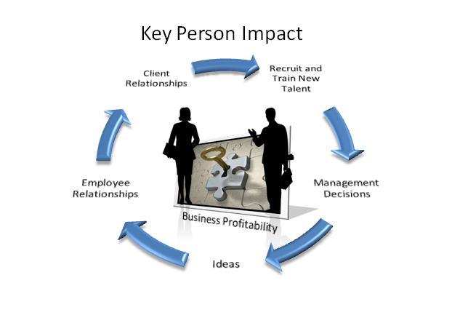


Is a Qualified Plan a Good Idea for You?
Business Owner Impact
Notes:
Part of what we need to consider is whether a qualified plan is a good idea for you. We’ll help you to understand the qualified plan’s impact on:
The potential impact on you and your business.
Your key people,
The tax implications – on the contribution, accumulation and distribution.

Slide 3

A Singular Concept
Tax Advantaged
Reward Yourself
Benefit Employees
Notes:
Qualified plans really are a singular concept supported in the tax code and controlled by a set of rules set out in the code and through a law called ERISA which stands for Employee Retirement Income Security Act of 1974. The overriding concept of a qualified plan – no matter what type – is that the contributions and the accumulation period have tax advantaged status under the tax code. That’s pretty important as there aren’t many tools that have that combination of tax advantages. Whether that particular combination of tax advantages is vital to you will be something we will explore.
Even in a qualified plan, designs can often direct the bulk of the benefits to you and your key people. If your business strategy is to reward yourself and provide benefits to your employees – as incentives or reward - a qualified plan can help you meet this strategy. Let’s look a little more closely.

Slide 4
Tax Deductible and Not Includable
Business Tax Deduction
Not Included in Participant’s Gross Income
Notes:
Here are some basics.
When you use a qualified plan, the annual business contributions to the plan will be completely tax deductible to the business. That makes for efficient cash flow for the business. Importantly, the contribution made on behalf of the employee, which we refer to as a participant in the plan, will not be included in the participant’s gross income, so you pay no current income tax on the money contributed to the qualified plan for your benefit.

Slide 5

Tax Deferred Growth
Growth not currently
included in the gross income of participant.
Notes:
Continuing with the tax advantages – during the accumulation phase any growth in the assets held in the qualified plan will not be subject to a current tax. This is often referred to as tax deferred growth. That allows the growth, if any, to continue untouched by a current tax.

Slide 6

Purchase Life Insurance with Pre Tax Dollars
Permanent Life Insurance
Notes:
Also, a particularly unique feature, many qualified plans are able to purchase life insurance, held in the plan, which will provide pre retirement death benefits to the participants family. The life insurance, in essence, helps to complete your plan for the benefit of your family if you died prematurely.

Slide 7
Distributions From Plan
1
Included in Participant’s Gross Income
2
Life Insurance Death Benefits Received Income Tax Free*
Permanent Life Insurance
* IRC Section 101(a) (There are some exceptions to the rule)
Notes:
At the point of distribution, retirement benefits received will be included in the recipient’s gross income.
If life insurance was included in the plan, when death benefits are paid out, the pure amount at risk (death benefit minus cash value) will be received by the beneficiary income tax free.

Slide 8
Common Types of Qualified Plans
Profit Sharing Plan
401(k) Plan
Defined Benefit Plan
Business
Business
Business
Flexible
Contributions
Matching
Contribution
Contribution Based on Planned Benefit
Profit
Sharing
Plan
401(k)
Defined
Benefit
Plan
Benefit based on separate account value
Benefit based on separate account value
Elective
Contribution
Predetermined
Benefit
Participant
Participant
Participant
Notes:
I’ve shown three of the most common types of qualified plans.
The first is a profit sharing plan. The business creates the plan and will make annual contributions to the plan. These are flexible contributions and may be adjusted up and down, depending on business performance and other factors. The profit sharing plan is a defined contribution arrangement, so the ultimate benefit to the participant will be based on what the participant’s account has grown to over the years. The profit sharing plan is one of the most popular arrangements.
Next is the 401(k) – and I’m guessing you’ve heard of it. These types of arrangements have become a dominant player in the qualified plan area. There are many plan designs possible under the 401(k). The keystone of most 401(k) plans is the participants deferral of current income – electing to deposit a percentage of current income into the plan. To encourage it’s use, the tax code provides that qualifying contributions into the plan are made on a pre tax basis. That element may be very attractive to the participant. The business may, but does not have to, design the arrangement to provide a matching contribution to the arrangement.
It’s not unusual to see both a profit sharing plan and a 401(k) provided by a business.
Finally, we have the defined benefit plan. There are also numerous plan designs possible. We often find a defined benefit plan in a closely held businesses where the business owner is older than the employees but the plan may also be attractive in all types of situations. The hallmark of a DB plan is that the plan promises to pay a predetermined benefit at retirement. The contributions are calculated to create a fund of money in the trust to be able to pay out that benefit at normal retirement. A DB plan often results in much higher allowable contributions than the defined contributions plans we just looked at.
As you can see, these are all very different plans. Which one, or which combination of arrangements is best suited to your case will depend on lots of variables. As we review the facts of your situation we will explore with you how these plans can help you achieve your business and personal goals.

Slide 9
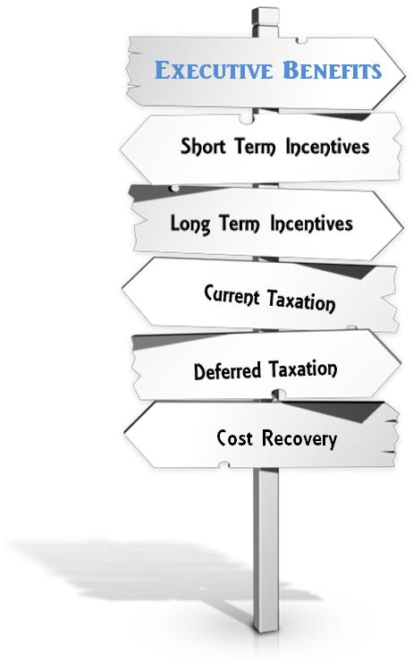
Moving Ahead
Qualified Plans
Cash Flow
Flexibility
1
Many designs are available
Tax Deductible Life Insurance
2
Numerous factors drive the selection
Key Executives
Contribution
Notes:
Even in this brief overview, you can see there are many powerful incentives encouraging the use of a qualified plan as a way to enhance an employee’s life, build retirement benefits, provide life insurance, and to create tax deductions for a business.
Many designs are possible and numerous factors will drive the selection including cash flow, the need for flexibility, whether you want tax deductible life insurance, how many key executives there are, whether you want the employees to contribute.

Slide 10
Next Steps
1
Get the Business census
2
Review the Business financial statements

